Slide 1
PIRMA User Guide
Version 1.0
May 2024

Slide 2
PIRMA User Guide
Table of Contents
What is PIRMA………………………………….4
Access to PIRMA………………………………5
PIRMA Home Page……………………………6
PIRMA Users…………………………………….7
Setting up a New Project in PIRMA………..8
Defining Risks in PIRMA …………………..9-10
Entering New Risks in PIRMA……………11-12
Updating Risks in PIRMA………………...13-14
Entering Risk Mitigation in PIRMA ………...15
Updating Mitigations in PIRMA……………16
Exporting in PIRMA…………………………..17
Closing a Project in PIRMA…………………18
Notes:
Wont need in BrainShark

Slide 3
What is PIRMA
Peripheral Interventions Risk Management Application
PIRMA is a web-based risk management application.
One of the Peripheral Interventions (PI) New Product Development Initiatives is “Pulling Risk Forward (PRF)”
The PIRMA tool is the PI-PRF Risk Management tool for repositing, tracking, quantifying and mitigating project risks.
Using PIRMA for Risks is required for all PDP and TDP projects. It is also required for all sustaining projects where the risks are being captured and will be mitigated.
If you have a unique exploratory project (sometimes called an umbrella project number) that includes other projects that share a project number but you would prefer to separate their risks, we can work with you to set up separate entries in PRIMA. Please contact the PI PMO PIPMOTeam@bsci.com if you have any questions about this.

Slide 4
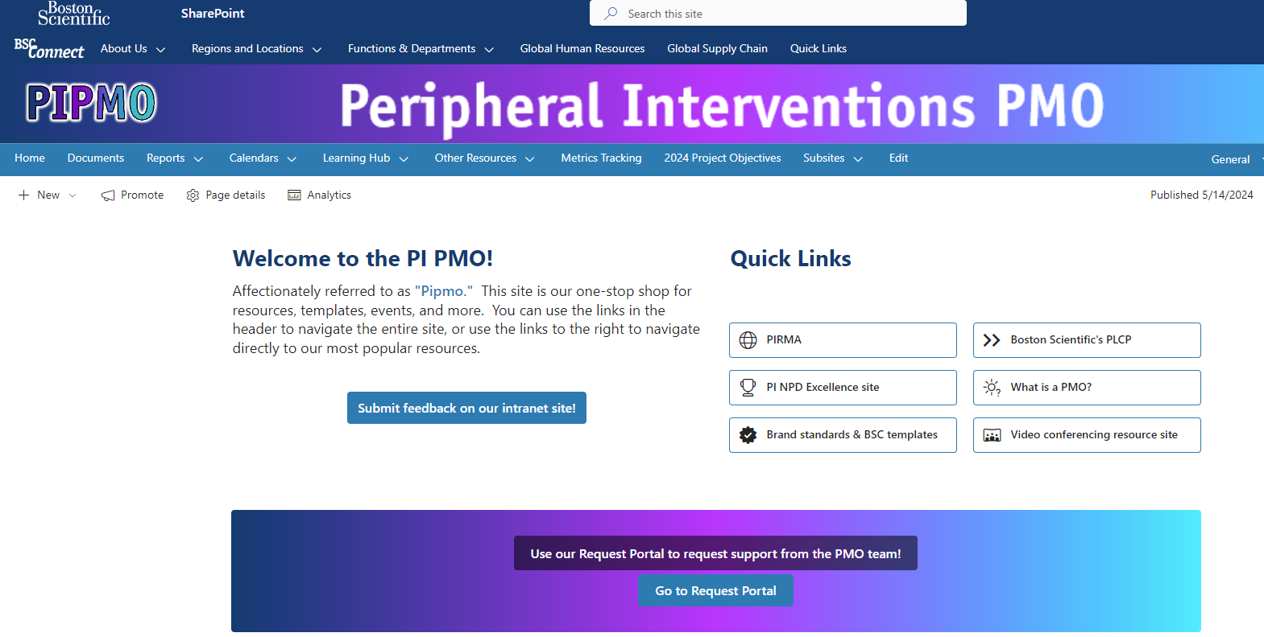
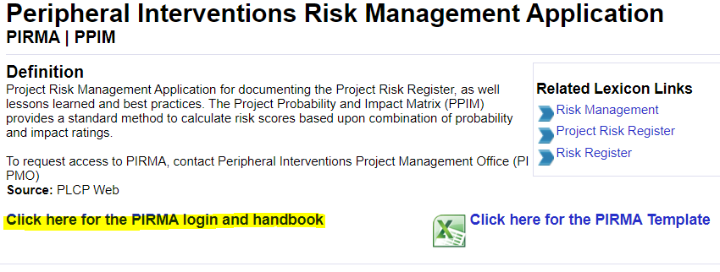
Access to PIRMA
Here is the link to PIRMA - PIRMA -Dashboard (bsci.com)
It can also be reached from the PI PMO SharePoint site homepage or by searching “PIRMA” in Lexicon

Slide 5
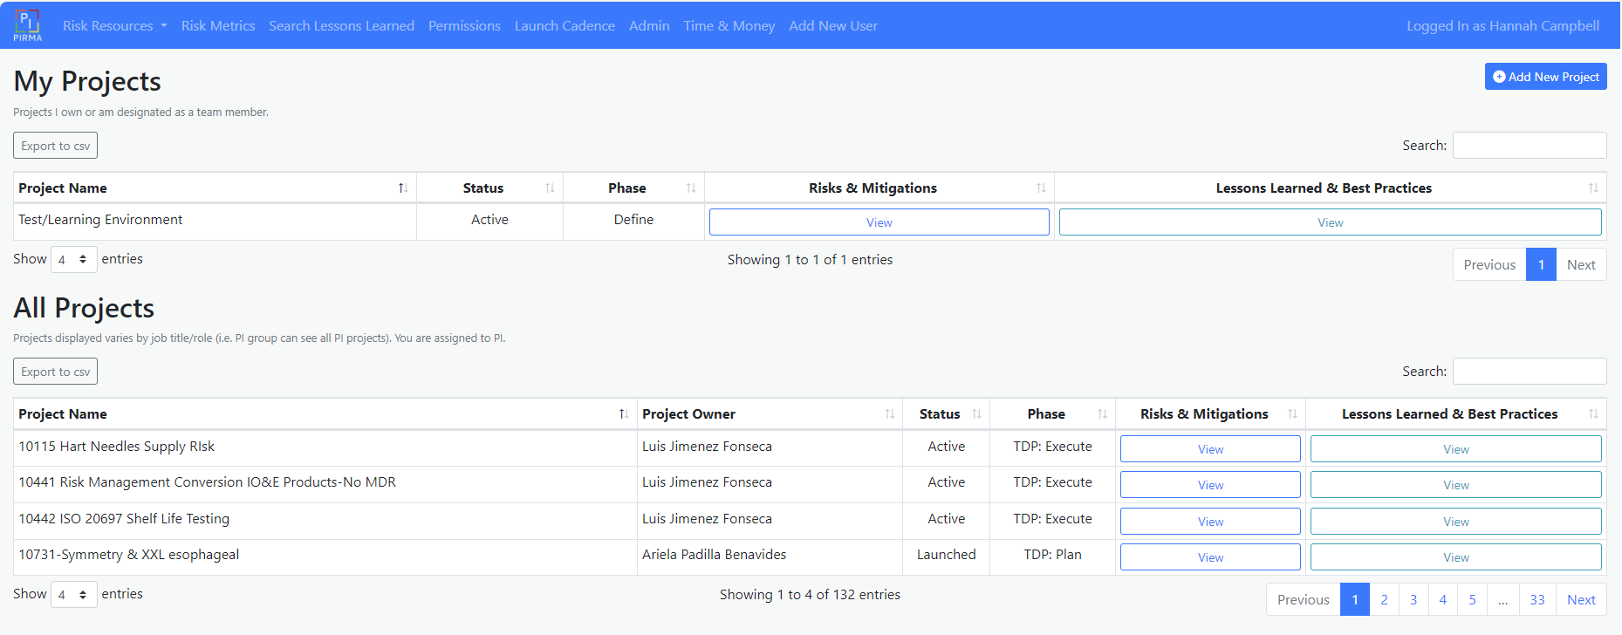
PIRMA Home Page
PIRMA -Dashboard (bsci.com)
Use search bar to find projects
Click on “view” to open the project
Expand entries to see more projects
If you cannot find a project you think you should be able to see in PIRMA, please contact PI PMO

Slide 6
PIRMA Users
Roles & Responsibilities
General overview of tasks and responsibilities of PIRMA users
Tasks | PMO Support | Project Manager | Project Team | Risk & Mitigation Owners
Add new users | X
Create new project | X
Assign project owner | X
Assign project team members |  | X
Enter Risks |  | X | X
Enter Mitigation |  | X | X
Assign Risk and Mitigation owners |  | X | X
Review and Monitor risks and mitigation |  | X | X | X
Manage / update risks |  |  |  | X
Manage / update mitigation |  |  |  | X
While Project Managers are typically responsible for overseeing risk management process, entire project team is responsible for identifying, mitigating and reporting project risks!

Slide 7
Setting up a New Project in PIRMA
If you are new to PIRMA and cannot see any projects, the PMO team will need to add you to the system.
To add a new project into PRIMA, please contact the PMO team through the PIPMO mailbox so they can initiate the set up.
Information needed to enter a new project is:
Project Manager/Owner Name
Project name – format
Division – PI, or IC etc.
Franchise – Arterial, Venous, IO, Coronary Therapies, Watchman, Cork projects, Devoro Integration, SHV
Organization (optional) NPD or Sustain Eng
Once project set up is complete, the PM can add team members and risks. If you can’t find a team member in PIRMA yet, please contact PMO

Slide 8
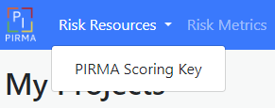
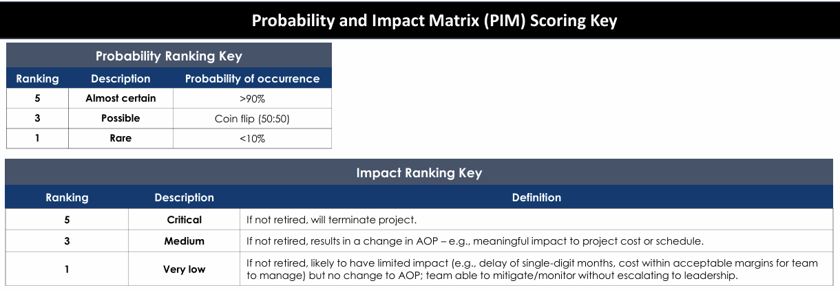
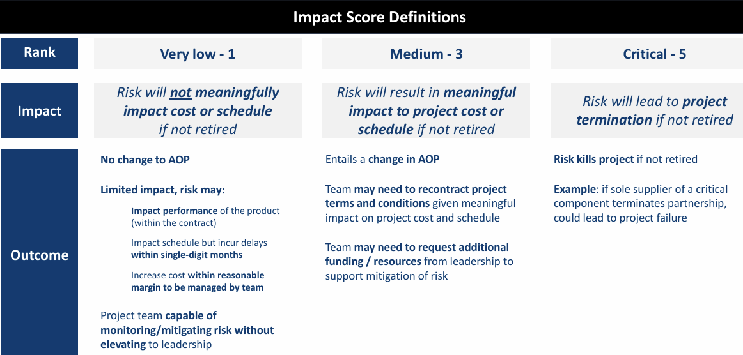
Defining Risks in PIRMA
Impact and Probability Scoring
Before entering Risks, review the PIM Scoring Key, Impact Ranking Key, and the Impact Score Definitions to determine how to define and rank the project risks.
Risk scoring key is in PIRMA Homepage navigation bar under Risk Resources

Slide 9
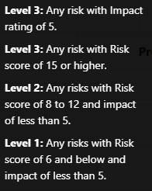
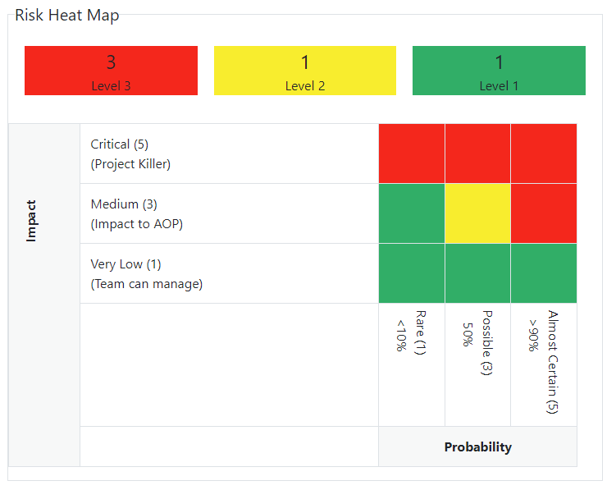
Defining Risks in PIRMA
Risk Level
Risk level is automatically assigned based on Impact Ratings and Risk Scores
Risk Heatmap has been updated to show risks by “level” instead of “scores”. All level 3 risks will be highlighted as “red” in the heatmap.

Slide 10
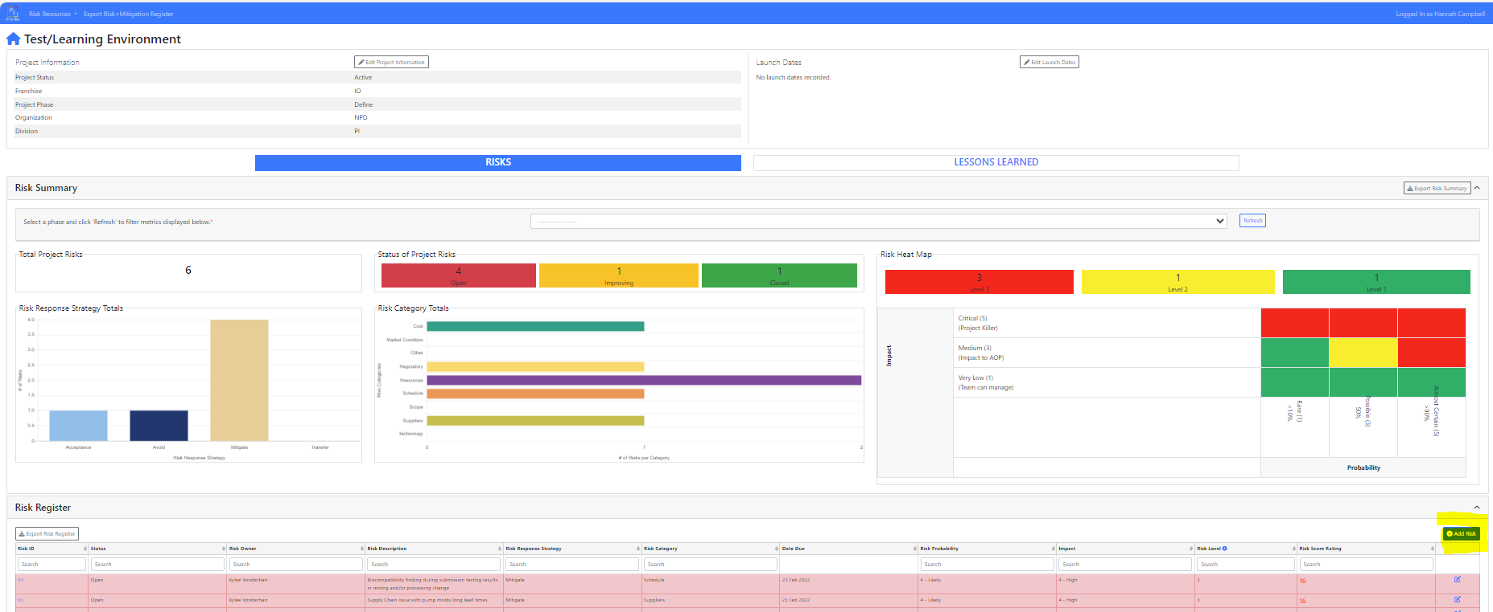
Entering New Risks in PIRMA
Once the project is set up, project team can add a risk by selecting the “Add Risk” Button in the Risk Register section

Slide 11
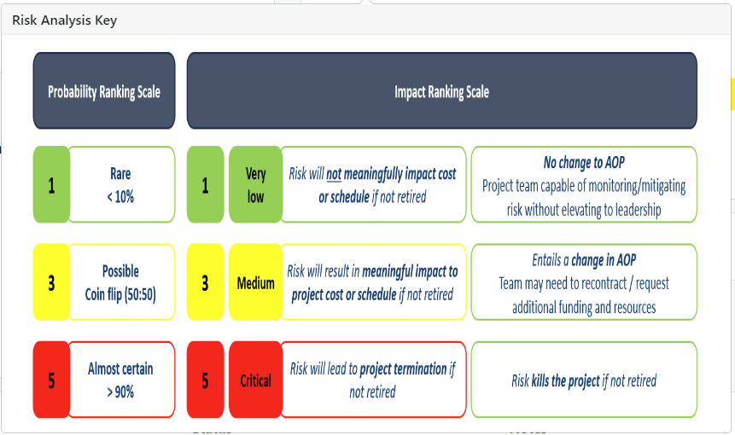
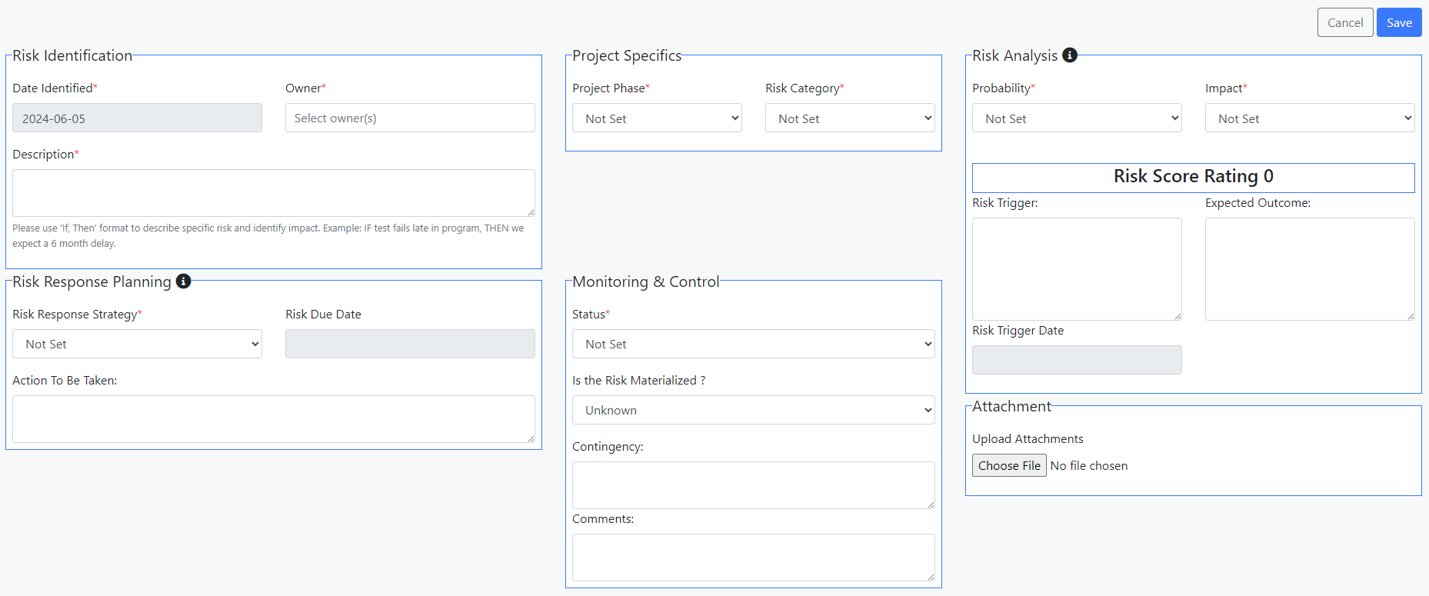
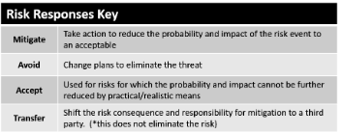
Entering New Risks in PIRMA
Fill in the required fields and desired optional fields.
While it is not mandatory to add “Risk Due Date” when entering new risk, it is strongly recommended to add due date as more details are available. This date will be used to send automated reminders to risk owners.

Slide 12
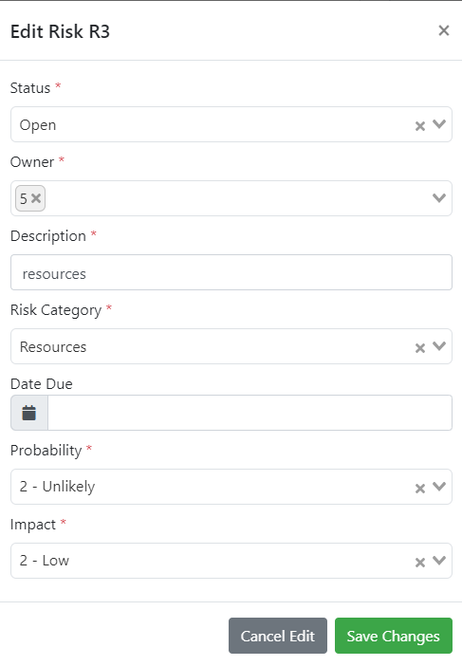
Updating Risks in PIRMA
First edit option
The first way to update an existing risk, is select the Risk edit button in the far-right column in the Risk Register
A box will open allowing for quick changes to the risk.
Only the information shown in the Risk Register can be edited using this option. To edit all the risk fields, use the second edit option.

Slide 13
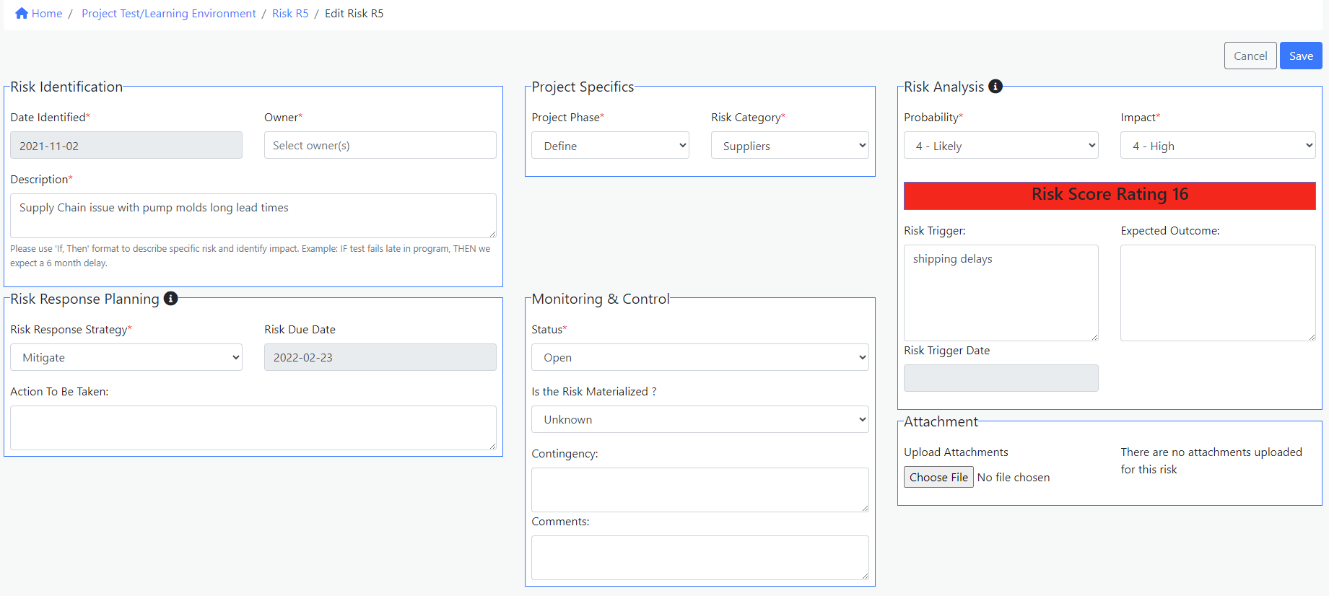
Updating Risks in PIRMA
Second edit option
To update an existing risk, select the Risk ID from the Risk Register
Select Edit

Slide 14
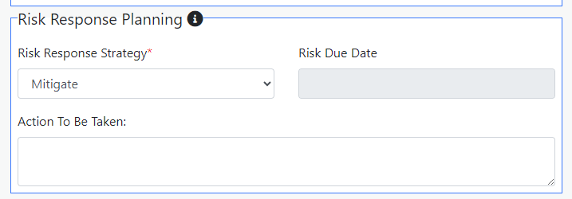
Entering Risk Mitigation in PIRMA
Mitigate = Take action to reduce the probability and impact of the risk event to an acceptable
To add a mitigation to a risk, open the risk and under the Risk Response Planning section
Select “Mitigate” from the Risk Response Strategy dropdown
A new Mitigation section will appear to fill in

Slide 15
Updating Mitigations in PIRMA
First and second edit options
Similar to Risks, Mitigations can be edited by:
Select the Mitigation edit button in the far-right column in the Mitigation Register.
To update an existing mitigation, select the Risk ID from the Risk Register. Select “Edit” button, this will open the risk and mitigation for editing

Slide 16
Exporting in PIRMA
Export the Risk Summary image (including the total project risks, status of project risks, and risk heat map) using the button
Export the Risk Register as an excel using the button
Export the Mitigation Register as an excel using the button
Export the Risks & Mitigations together as a csv using the navigation bar button

Slide 17
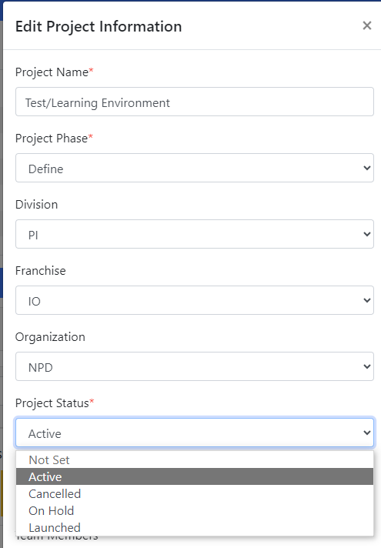
Closing a Project in PIRMA
PIRMA is a “living tool” that is intended to be updated as a project progresses
If the project is ready to close, please update the risks and mitigations first, then update the project status to Launched
If the project is moving to On-Hold or Cancelled, then also update the project status

Slide 18
Thank you! Please send questions to PIPMOTeam@bsci.com

